Slide 1
Club Rotario Tepic
District 4140 México
Name of Club: Tepic Rotary Club
Name of Project: Kitchen Equipment and Playground

Slide 2
1. Introduction
In 2006 a group of young people began to support a program to collect Christmas gifts for a children's shelter in the City of Guadalajara, Jalisco, from that moment on year after year and to date they continue to support this and other actions.
Knowing the need and reality in the state of Nayarit and specifically in the city of Tepic, in January 2012 Fundación Dar Amor, Dar Vida A.C. (FUNDAVID) was established, whose main objective is to develop shelters to provide assistance to minors in vulnerable situations due to domestic violence, abandonment or orphanhood.
FUNDAVID is a non-profit, non-governmental institution, whose purpose is to improve the quality of life of minors who suffer abandonment, domestic violence and orphanhood, through the opening of "Children's Homes" where their basic needs are met such as: balanced food, clothing, hygienic measures, as well as spiritual, medical, psychological care in crisis situations, educational programs, craft classes, and recreation.
But above all we seek to give them the love and attention they require.

Slide 3
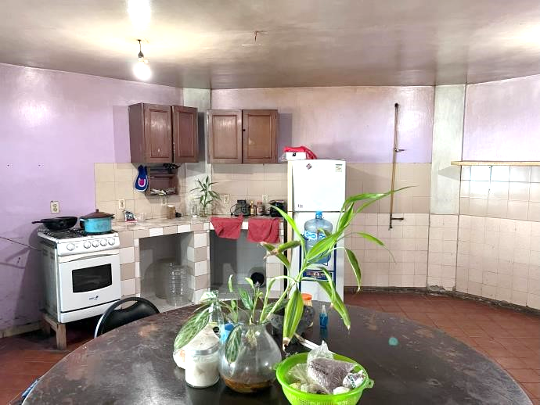
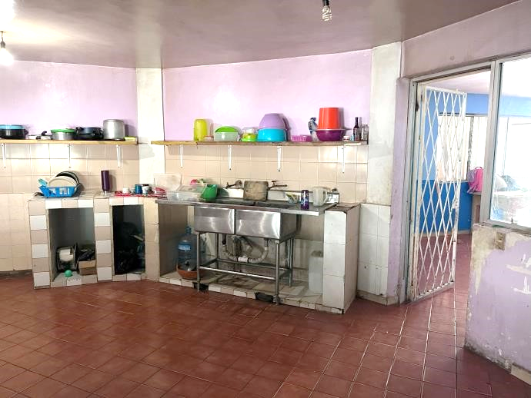
2. Objectives
Among the priority areas to be addressed in FUNDAVIDs new home is the kitchen equipment.
In addition, the Tepic Rotary Club is involved in other programs to provide toy libraries to various children's centers, so the provision of a playground for children's recreation is also considered.
With this investment, up to 40 children can benefit from the protection of the civil association "FUNDAVID".
The kitchen area and a playroom require an investment of $8,666.07 US dollars, approximately $164,655.32 Mexican pesos at a $19.00 MXN per USD exchange rate.

Slide 4
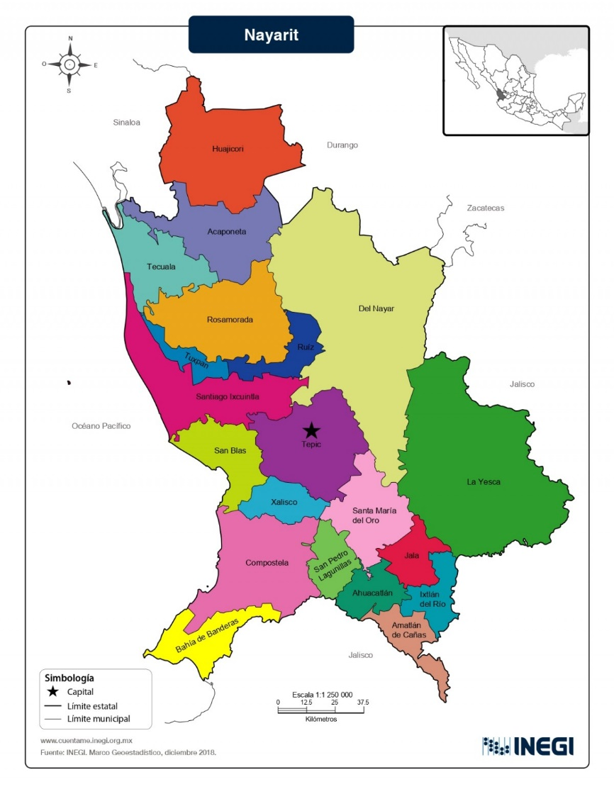
3. Location
Tepic, Nayarit

Slide 5
4. Budget
Concept | Quantity | Price per unit | Total (USD)
Upright freezer | 1 | $2,198.93 | $2,198.93
Vertical refrigerator 2 doors | 1 | $1,869.25 | $1,869.25
Convection oven | 1 | $3,650.52 | $3,650.52
Playground | 1 | $947.37 | $947.37
Total | 4 | $8,666.07 | $8,666.07

Slide 6
5. Petition
Sponsor 1 Rotary Club…………………………
Distrital FDD …………………………………….
Rotary Club …………………………………….
$ 6,932.85
$ -
$ 1,733.21
Project total in USD
$8,666.07

Slide 7
6. Contacts
NAME: CP Emilio Hernández Melo
CLUB POSITION: Club President 2024-2025
E MAIL: e.hernandez@hmvycia.com
PHONE: 52-1-311-250-8030
ADRESS: Bucerías 64, Col. La Huerta, Tepic, Nayarit, México, CP 63070
NAME: Dr. Jorge Sánchez Ibarra
CLUB POSITION: President of Projects 2024-2025
E-MAIL: jorgesanchezibarra@outlock.com
PHONE: 52-1-311-122-56-70
ADRESS: Hidalgo No. 86 Ote, Col. Centro, Tepic, Nayarit, México, CP 63000
NAME: Ing. Victorino Sánchez Romero
CLUB POSITION: Rotary Foundation President 2024-2025
E-MAIL: Victorino.consultor@gmail.com
PHONE: 52-1-311-116-41-24
ADRESS: Av. México No. 27 Int. 1 Centro, Tepic, Nayarit, México, CP: 63000

Slide 8
Rotary Club Tepic
Thank you

